Slide 1

AWS Tutorial 1
AWS VPC Tutorial | Public & Private Subnets with EC2, NAT Gateway & Bastion Host

Slide 2
Agenda
Introduction to AWS
Key Service Areas
Components of AWS tutorial 1

Slide 3
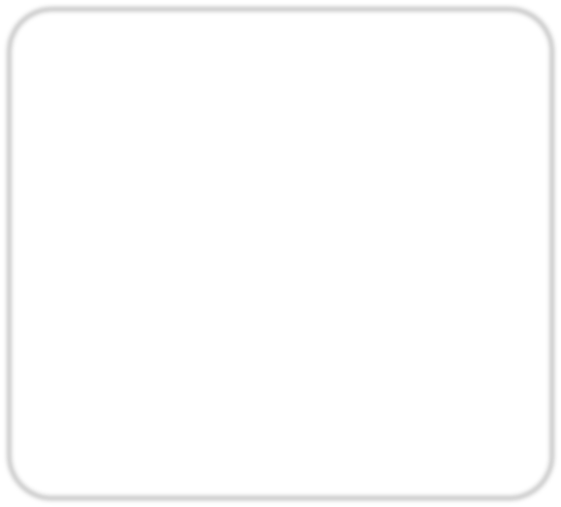
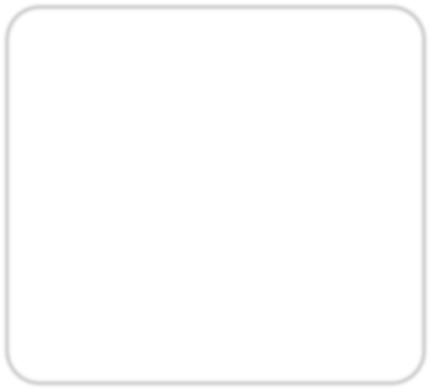
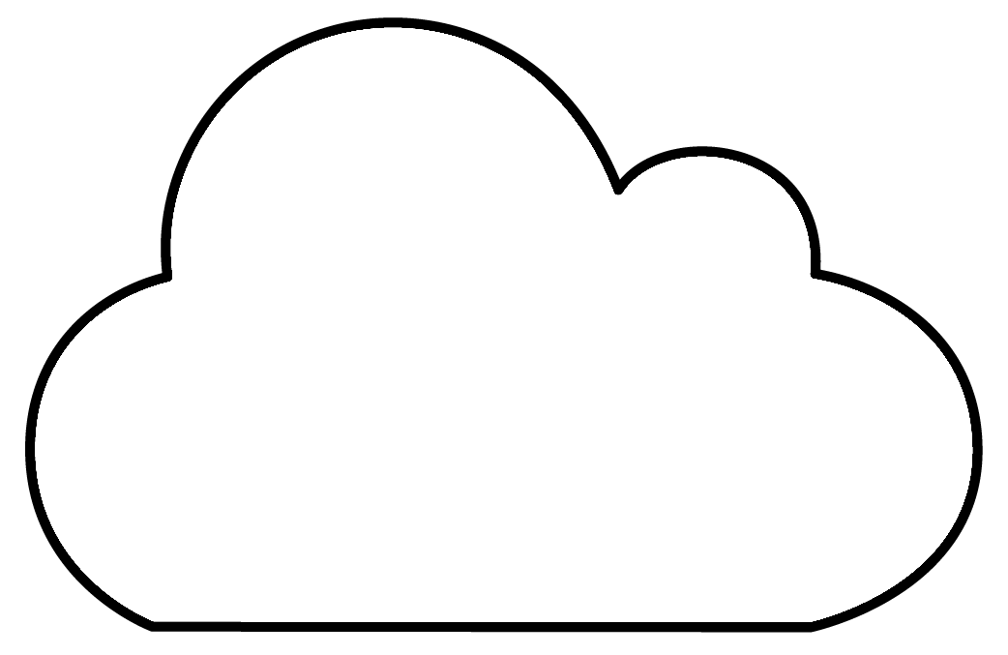
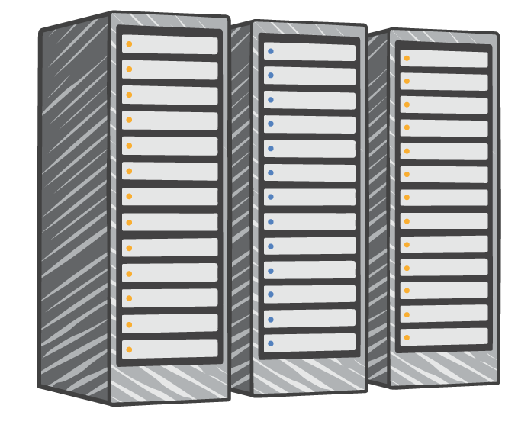
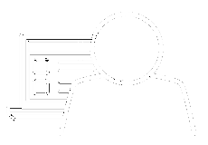

Introduction to AWS
Amazon Web Services (AWS) is a comprehensive cloud computing platform that includes infrastructure as a service (IaaS) and platform as a service (PaaS) offerings. AWS services offer scalable solutions for compute, storage, databases, analytics, and more.
Servers
Storage Databases
Applications
Cloud services provider
Servers Storage
Databases Applications
Internet
Network

Slide 4
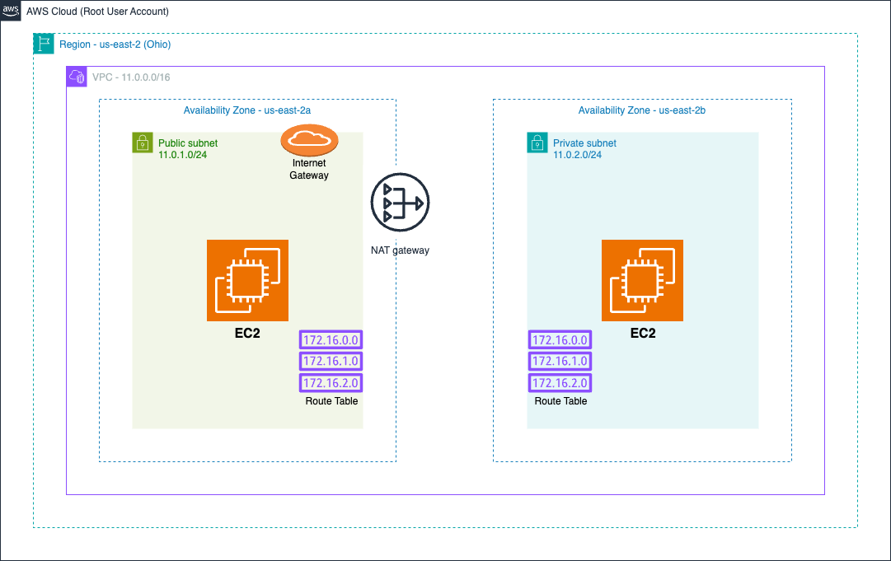
Components of AWS in Tutorial 1: EC2 Instance Setup in VPC in Public and Private Subnet
AWS Account
Virtual Private Cloud
Subnet
Security Groups
Internet Gateway
EC2
NAT Gateway
Route Table

Slide 5


Slide 6
Getting Into AWS Account:
The AWS root user is the account's primary identity created when you first set up the AWS account.
In this tutorial, I'm using the root user for demonstration purposes.
⚠️ Note: While the root user has full access to all AWS services, it's a best practice to use IAM users or roles for day-to-day operations to reduce security risks.

Slide 7
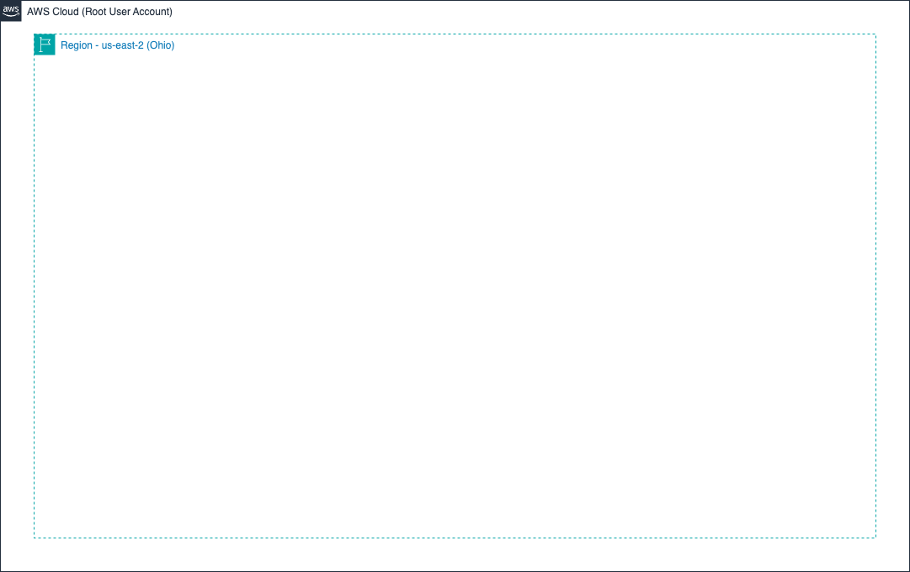

Slide 8
Selecting the Region: US-EAST-2, Ohio Region

Slide 9
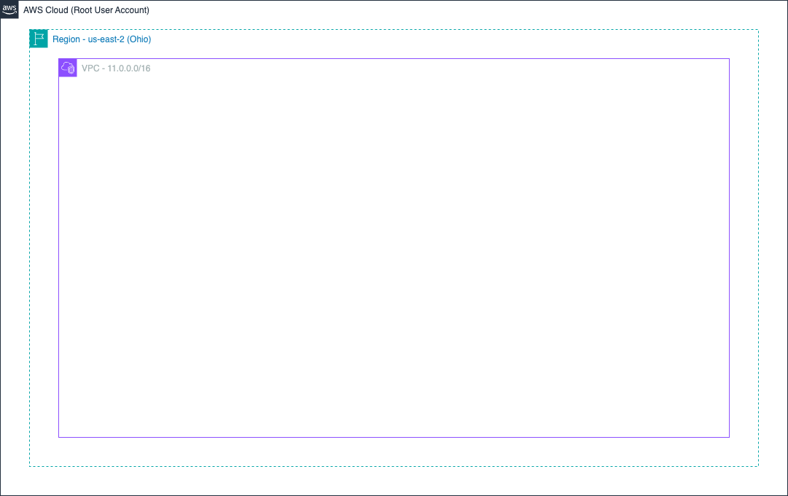

Slide 10
VPC – Virtual Private Cloud
In AWS, when creating a VPC, you have two options:
VPC Only – creates just the VPC.
VPC with More Options – allows you to configure subnets (public & private), route tables, etc.
For this tutorial, we’ll use “VPC with more options” so we can:
Define public and private subnets
Set up routing and gateways
Launch resources in isolated network segments
While creating the VPC, we need to specify a CIDR block (Classless Inter-Domain Routing) – which defines the IP address range.
I’m using: 11.0.0.0/16 This gives us 65,536 IP addresses to use in our subnets.

Slide 11
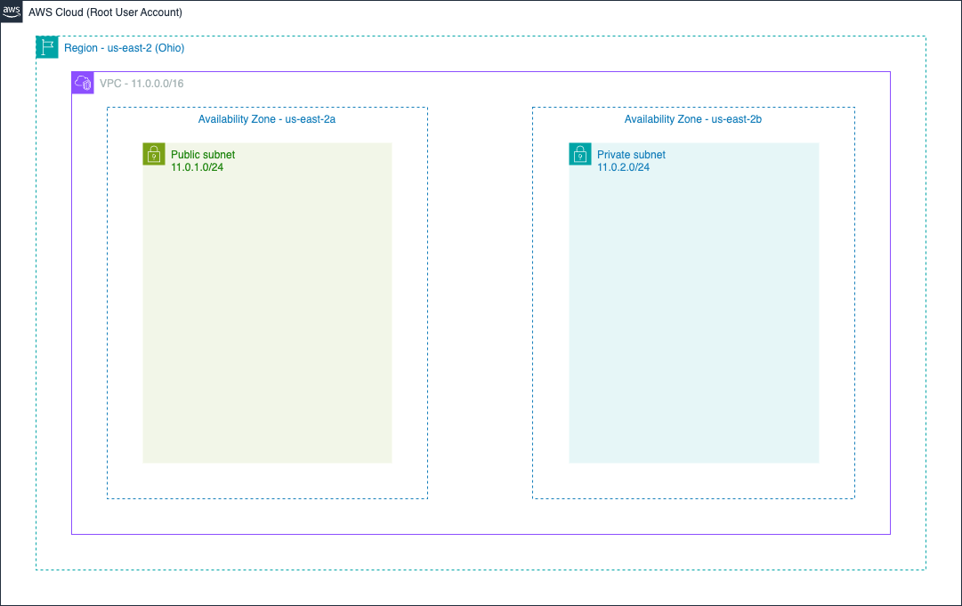

Slide 12
Subnet: Public and Private
Creating Subnets in the VPC
Public Subnet: 11.0.1.0/24 (Supports 256 IP addresses, typically used for web servers or bastion hosts)
Private Subnet: 11.0.2.0/24 (Also 256 IPs, used for databases or app servers without internet exposure)

Slide 13
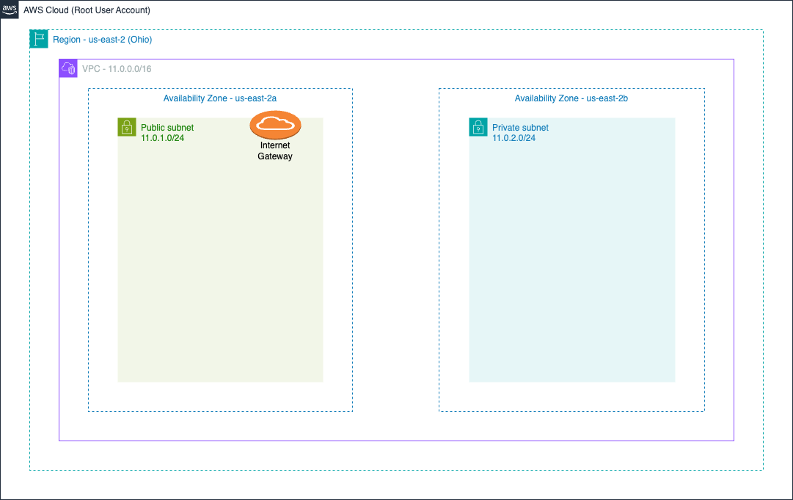

Slide 14
Internet Gateway:
An Internet Gateway allows EC2 instances in our public subnet to access the internet and receive traffic from it.
It serves as a bridge between the public subnet in our VPC and the outside world.

Slide 15
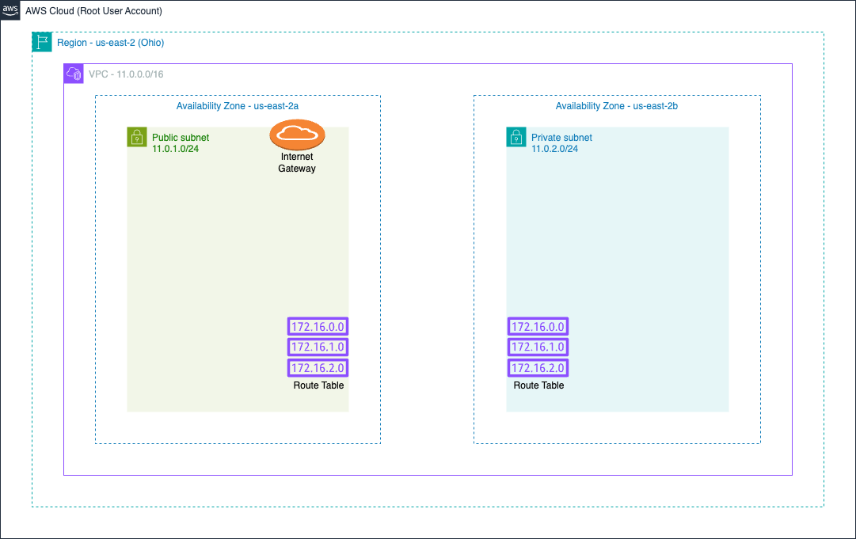

Slide 16
Route Tables
Now we need to create route tables for our VPC.
The public route table will include a route to the Internet Gateway, allowing public subnet resources to access the internet.
The private route table will remain internal or use a NAT Gateway for outbound access.
After creating the route tables, we must associate each one with its corresponding subnet:
Public route table → public subnet
Private route table → private subnet
This setup ensures that traffic is routed correctly based on the subnet’s purpose.

Slide 17
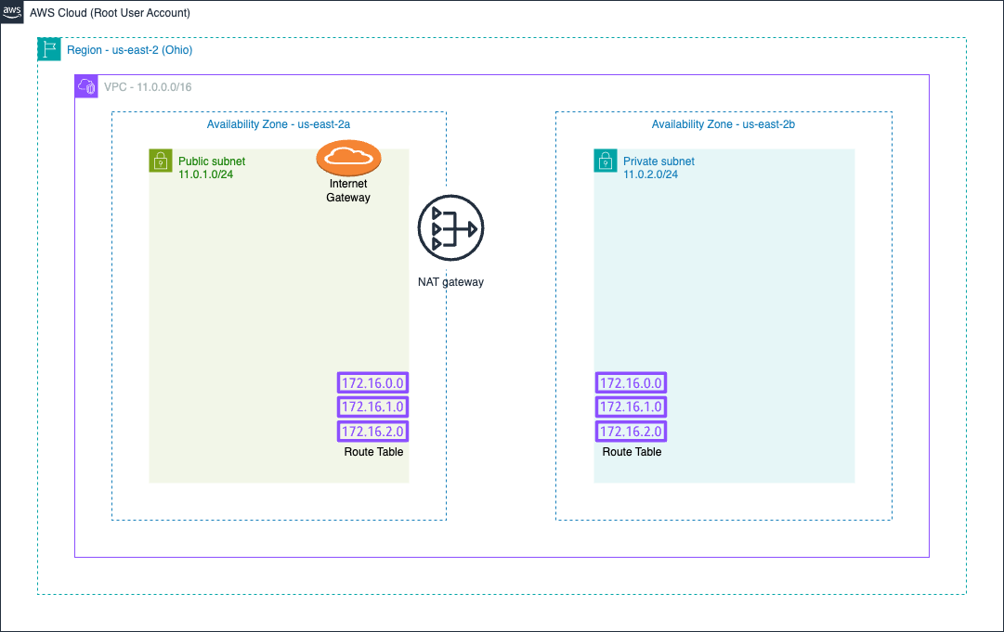

Slide 18
NAT Gateway
NAT Gateway (Network Address Translation) allows instances in a private subnet to access the internet without exposing them to incoming traffic.
This is helpful when your private EC2 instance needs to download updates, access external APIs, or reach public services.
You cannot assign an Elastic IP directly to private instances, so the NAT Gateway acts as an intermediary.
The NAT Gateway is placed in the public subnet, and the private route table must have a route pointing to it:
Route: 0.0.0.0/0 → NAT Gateway
This ensures outbound internet traffic from the private subnet goes through the NAT Gateway securely.

Slide 20
THANK YOU

